Slide 1

Results from the implementation of the Communication Plan of Operational Programme on “Transport” 2007-2013

Slide 2
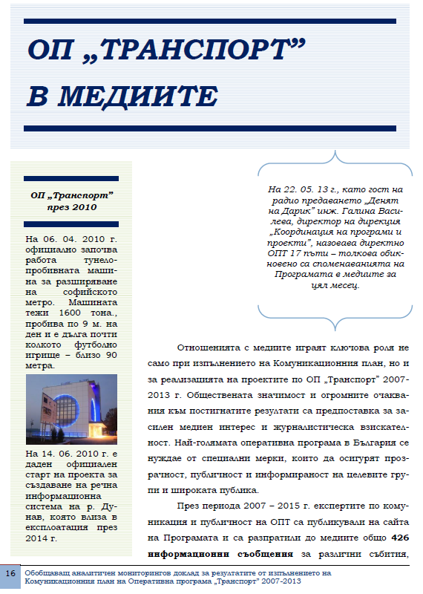
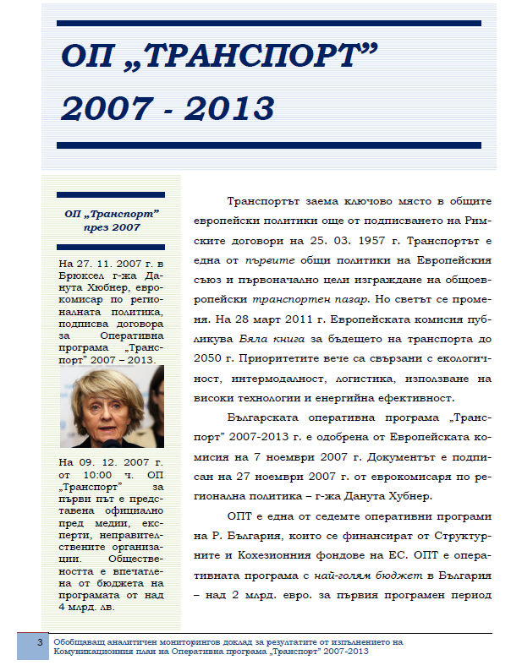
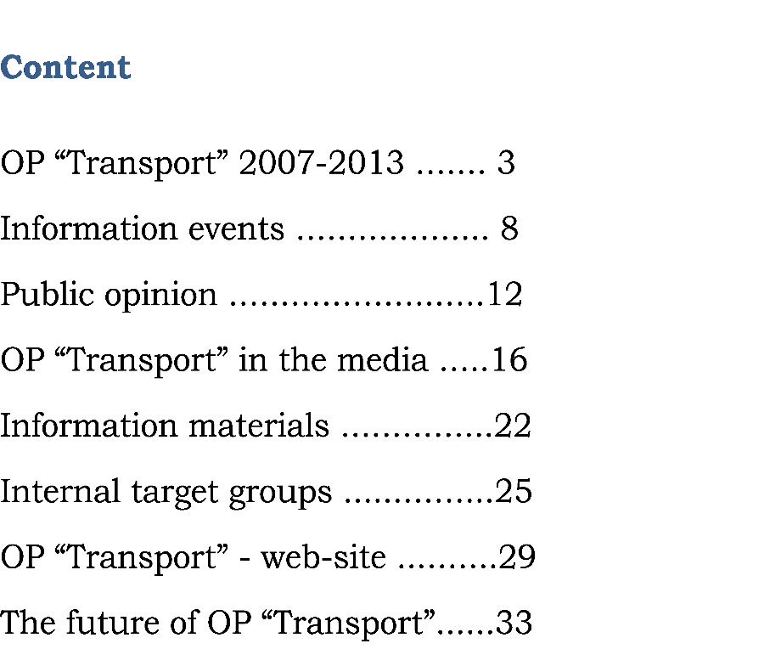
Retrospection 2007-2015

Slide 3
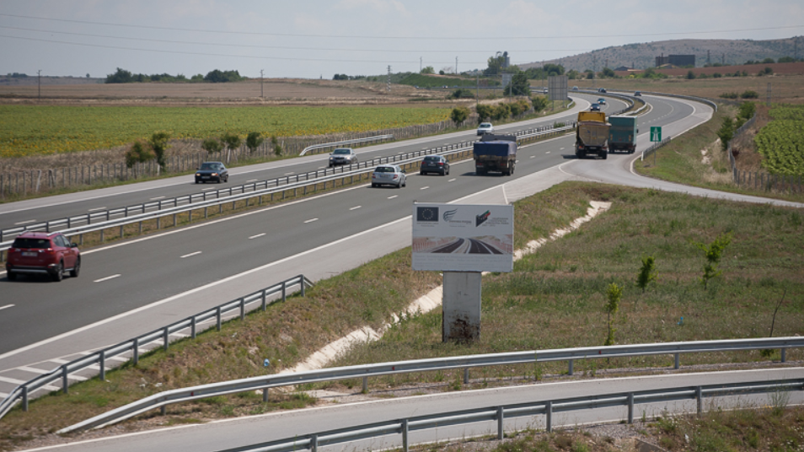
Communication plan tasks
Information activities
Awareness activities
Image campaign
Public opinion

Slide 4
Information events
Increase of the number of the information events on annual basis in the period: 2007-2015;
136 information events conducted in total;
After 2012 – more than 20 events per year;
At the end of the programme period every second event is an opening ceremony of a programme object.

Slide 5
Information events
From 2012 the satisfaction of the participants has been measured

Slide 6
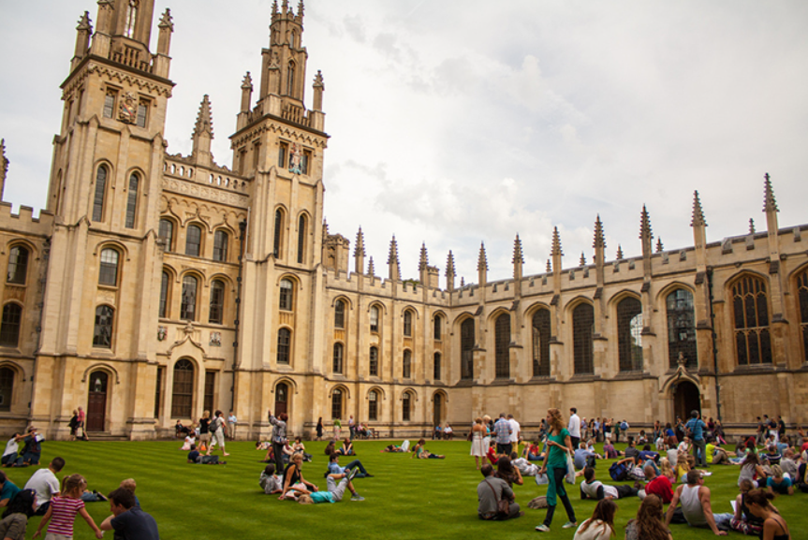
Information materials
99 600 information materials in 2007-2013 (enough for all the citizens of a city with the size of Oxford);
22 video-materials.

Slide 7
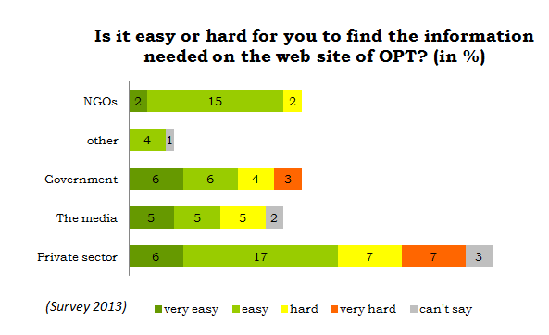
OP “Transport” web-site
500 000 visitors at www.optransport.bg
426 information messages
In 2012 a growth of nearly 100%

Slide 8
OP “Transport” in the medias
13 060 publications in the medias about OP “Transport” (one message on every 6 hours);
At the end of the period 86% of the publications are positive, 3% are negative;
After 2012 a media monitoring has been conducted, which covers TV, radio, press and Internet;
Instagram, You Tube, Google+ profiles of OP “Transport”.

Slide 9

OP “Transport” in the medias
Closing information campaign in 2015: TV, radio, press; 114 514 unique visits on the web-site

Slide 10
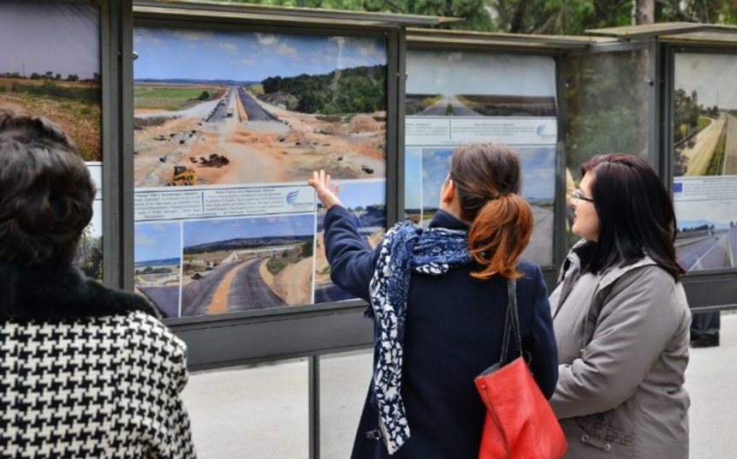
Internal target groups
2 surveys among the internal target groups – 218 in-depth interviews about communication, management and control.

Slide 11
Public opinion
7 nationally representative sociological surveys;
7017 interviews (15+ years).

Slide 12
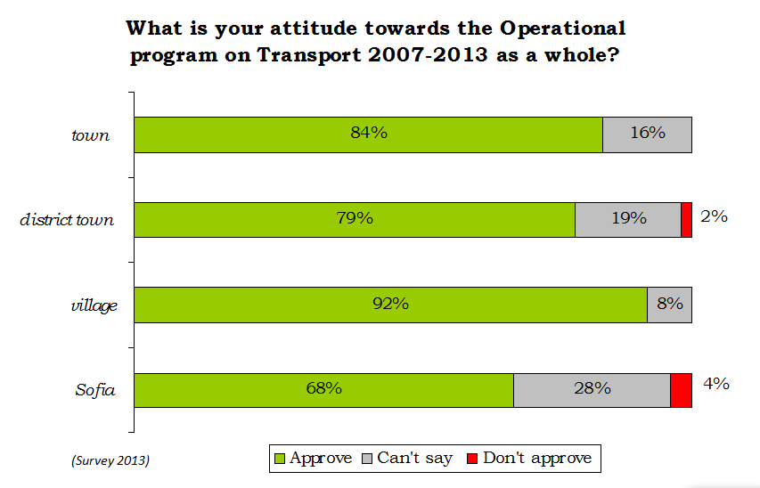
Public opinion

Slide 13
The future of OP “Transport”
Awareness of the social groups
75% of the owners and partners in the private sectors know OPT
65% of the intellectuals know OPT
30% of the students know OPT

Slide 14
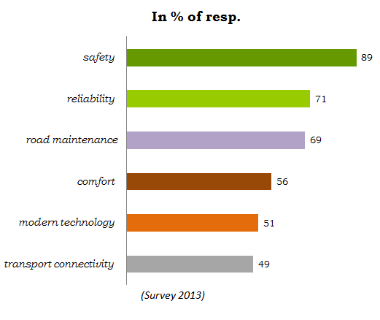
What is important when you travel?

Slide 15
Most successful are the campaigns when:
The event is focused on fewer, but more specific topics;
Opportunities for dialogue and discussions are envisaged;
There are conditions for clear visualization of the messages through photo and video materials;
The working materials from the event are accessible in paper and electronic variant.

Slide 16

Thank you for your attention!
I am expecting your questions and recommendations!

