Slide 1
“Lessons Learnt” workshop on 18th June, Sofia
Project Implementation Support Service Agreement (PISSA) TA2013040 BG BSF
S6 - Capacity building
István HEINCZINGER, EIB Transport Specialist, Sofia

Slide 2
Project Implementation Support Service Agreement – Activity 3, “lessons Learnt” workshop
Employer capacity deficiencies:
Conflicts with:
Politicians
EU Directorates
Managing Authority
Auditors
Government Ministries and Authorities
Local Authorities - Municipalities
Other institutions
(Custom Agency, Border Police, Archaeologists, Utility Owners, Electricity Companies, Industrial Plans, Forestry Funds, Railway Operators, Neighboring Countries railway infrastructure managers)
Independent (???) Supervising Engineer
Contractors
PMIU
NRIC organisation and operations

Slide 3
Project Implementation Support Service Agreement – Activity 3, “lessons Learnt” workshop
How solve the conflicts?
What kind of capacity building measures are needed in the future?
For Politicians:
Clear strategy approved by all political parties and civil professional organisations
It is not the task of the Employer
BUT: Government responsibility with the support of NRIC
Recommendation: NRIC needs a very strong strategic department (JASPERS and ARUP study) – DONE (structurally) lack of good strategy makers, lack motivations and training

Slide 4
Project Implementation Support Service Agreement – Activity 3, “lessons Learnt” workshop
EU Directorates – indirect conflicts, however from capacity building point of view NRIC needs:
Qualified personals and organisation
Speaking perfect English
Having excellent knowledge of EU directives and regulations
Permanent communication and problem solving process during the project implementation towards EU together with MA
Partially DONE (structurally) – efficient certified training is “must”

Slide 5
Project Implementation Support Service Agreement – Activity 3, “lessons Learnt” workshop
Conflicts on MA level:
Communications problem between Beneficiaries and MA
Controlling function of MA is not efficiently used
Monitoring function is not appropriate: frequency and the follow up and control process point of view
Recommendation: Permanent training and incentives programme for highly qualified personal
Auditors Level:
At least 4 different auditing process, lack of professional auditors on each national levels (Employer, MA, MoF) – project financing effect and delay of implementation
Recommendation: Harmonisation of the auditing processes

Slide 6
Project Implementation Support Service Agreement – Activity 3, “lessons Learnt” workshop
Government level:
Lack of supporting process for large infrastructure project (permitting period timeless)
Lack of appropriate communication between concerned ministries (MoF contra BDB, MRD and MTITC, Archaeological Institute and Beneficiaries, Procurement Agency and Beneficiaries)
Recommendation: Implement the existing laws or make a special law for large infrastructure projects of having social and strategic interest for the Bulgarian society in order to speed up the lengthy permitting procedure and avoid delays
Municipality level:
Monopolistic situation in the permitting process – not eligible extra costs for projects – difficult to manage on Beneficiary level the behaviour of the Municipalities it needs legal framework to limit the unfavourable actions of the Municipalities
Other Institutions:
Involvement of all these institution in the early phase of the project preparation and approval.

Slide 7
Project Implementation Support Service Agreement – Activity 3, “lessons Learnt” workshop
Independent Supervising Engineer level
Low price – low quality of Engineer performance
Lack of capacity and expertise of the Engineers for large infrastructure projects
The Employer cannot leave alone the Engineer on the site and communication with the Contractors
The engineer is not interested in the project acceleration and give advices to the Employer in this respect.
The Engineer is not approaching the VO, Claims, extra works from the point of view of EU requirements and eligibilities
Recommendation: The Employer needs to have strong contract/FIDIC engineer knowledge and experts in the PMIU – Training is essential
Contractor level
Needs to have the international contractors:
Large international expertise in complex construction project
Large of experience to handle for own favour the complex situation
BUT:
Expensive
Subcontract most of the work to local companies
Poor local project management
Using political pressure
Very tough partner in claim and arbitration processes
Recommendation: The Beneficiaries need to build up its own competencies in order to avoid misuse of the contractor large experiences – Training of the state and appropriate process management, including claim, risk and contracting

Slide 8
Project Implementation Support Service Agreement – Activity 3, “lessons Learnt” workshop
PMIU level
New structure and processes for PMIU according to JASPERS and ARUP report – big improvement in process management with clear responsibilities
However it is room for improvement in terms of:
Claim management
Risk management
FIDIC contracting regulation
Experienced staff in large, complex infrastructure projects
As a result of above missing knowledge Dependence of Supervising Engineers
Recommendation: to train the members of the PMIU for the next programming period regarding project management, risk management, claim management, contracting and decision making procedure.
NRIC organisation
Lack of supporting process from other departments of NRIC
Lack of expertise in the NRIC organisation of land expropriation
Recommendation: Implement fully the JASPERS and ARUP report recommendation and further training of the functional and operating departments staff.
OR

Slide 9
Project Implementation Support Service Agreement – Activity 3, “lessons Learnt” workshop
New Legal Entity for Infrastructure projects – National Infrastructure Development Company (NIDC)
Ownership: State owned by MTITC (Based on the Law)
Responsibility: To manage all infrastructure projects (road and rail) funded by EU or from National Budget
Decision making process of project approval:
Project value (with VAT) < 1,0 M BGN – CEO + management responsibility
1,0 M BGN < Project value (with VAT) > 2,0 M BGN – Board of Directors and Supervisory Board
Project value > 2,0 BGN Project Directorate of the MTITC on behalf of the OWNER (with prior approval of BD and SB)

Slide 10
Project Implementation Support Service Agreement – Activity 3, “lessons Learnt” workshop
Process
The Council of Ministers – approving the annual infrastructure projects both EU and NB funded
NIDC – preparing the tender documentation (contract, special conditions of the contract, technical specification of the contract, calculations, cleared land acquisition, design) and submitting to the MTITC Project Department for approval
Time for approval (by MTITC) maximum 30 calendar days.
NIDC – receiving the approval and publishing the tender documents in 2 national newspapers and on the EU, MTITC and NIDC official website
45 days for submitting the bid by international or local companies

Slide 11
Project Implementation Support Service Agreement – Activity 3, “lessons Learnt” workshop
Structure of the NIDC
Owner and its main responsibilites
Appointment of CEO, Deputy CEOs and member of the BD and SB
Approval of annual budget and balance sheet of the company
Board of Directors – Representatives of road and rail infrastructure operators + CEO, 2 Directors (financial and operational)
Supervisory Board - Representatives of the different ministries and the owner: CoM, MoF, MRD, MTITC MoJ, Procurement Agency
CEO – functional responsibility of the company + HR
Deputy CEO – financial responsibility
Deputy CEO – infrastructure responsibility with 2 directors: 1., Director of Road Infrastructure Investment and 2., Director of Rail infrastructuure Investment
Functional departments

Slide 12
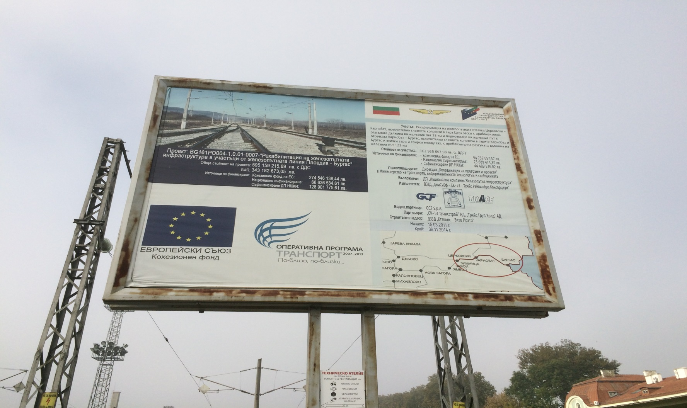
Project Implementation Support Service Agreement – Activity 3, “lessons Learnt” workshop
Thanks for you kind attention!

